Slide 1
Data Blitz – Working Memory
Gil Shotan and Lane McIntosh
4/12/2013

Slide 2
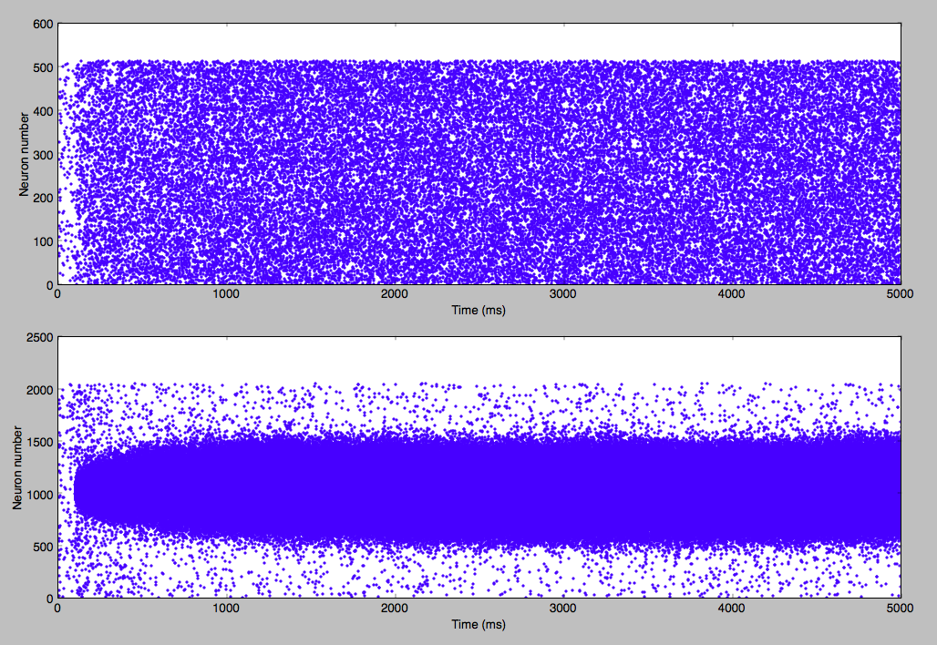
Raster plot of activity

Slide 3
Angle of pop vec against time (20 trials)

Slide 4
Variance of pop vec angle over time for three network sizes

Slide 5
Why does variance decrease with network size?
Explore sources of variability in neural firing (noise)
Stevens 1968 – due to asynchronous arrival of PSPs is primary source of neural noise, assuming a rate model

Slide 6
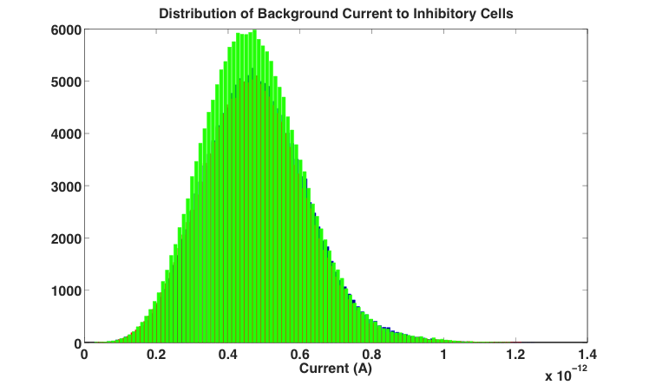
Variability due to network size

Slide 7
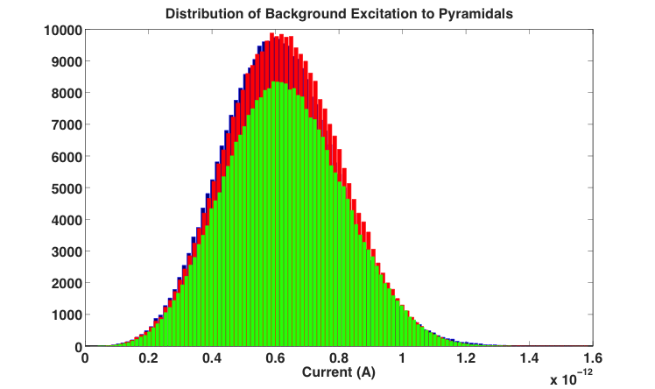
Variability due to network size

Slide 8
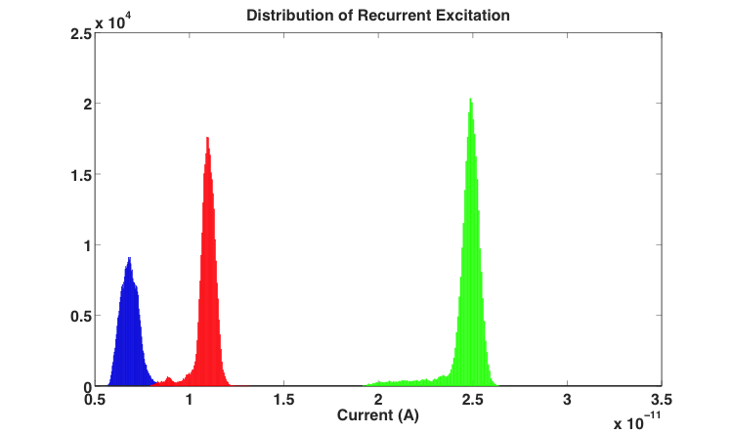

Variability due to network size
Range of background noise

Slide 9
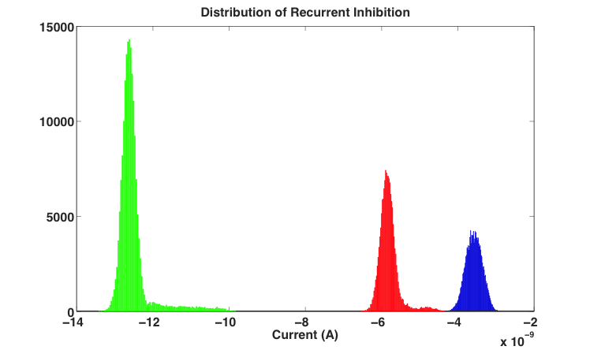
Variability due to network size

Slide 10
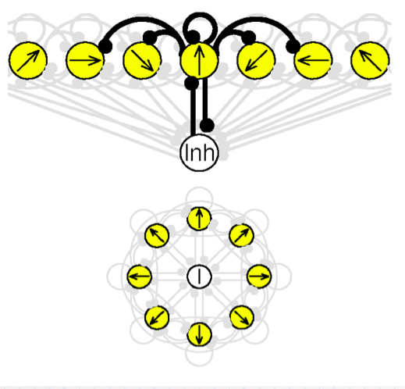
Ring structure of network
As network size increases,
more neurons are excited
during the stimulus
which in turn results in more recurrent inhibition
thus shutting off more strongly neurons with different orientation selectivity

Slide 11
How does heterogeneity influence working memory?
Sources of heterogeneity:
1) Membrane properties (g_L, C_m, V_threshold)
2) # and efficacy of connections
Wang et al. 2003

